Slide 1

PROGRAM STUDI INFORMATIKA
FAKULTAS TEKNIK DAN INFORMATIKA
UNIVERSITAS MULTIMEDIA NUSANTARA
SEMESTER GASAL TAHUN AJARAN 2023/2024
IF331 – PEMROGRAMAN DEKLARATIF
Pertemuan 07 – Review – Pre Midterm Test
Ivransa Zuhdi Pane, Tb Ai Munandar

Slide 2
Capaian Pembelajaran Mingguan Mata Kuliah (Sub-CPMK):
Sub-CPMK 9
Mahasiswa dapat memadukan konsep-konsep pemrograman logika yang telah dipelajari selama paruh pertama perkuliahan dan membangun aplikasi berbasis pemrograman logika
IF331 – PEMROGRAMAN DEKLARATIF – 2023/2024

Slide 3
IF331 – PEMROGRAMAN DEKLARATIF
Pertemuan 07 – Facts, Rules and Queries

Slide 4
Aim of This Lecture
Give some simple examples of Prolog programs
Discuss the three basic constructs in Prolog:
Facts
Rules
Queries
Introduce other concepts, such as
the role of logic
unification with the help of variables
Begin the systematic study of Prolog by defining terms, atoms, and variables
IF331 – PEMROGRAMAN DEKLARATIF – 2023/2024

Slide 5
Prolog
"Programming with Logic"
Declarative
Very different from other (procedural) programming languages
Good for knowledge-rich tasks
IF331 – PEMROGRAMAN DEKLARATIF – 2023/2024

Slide 6
Basic Idea of Prolog
Describe the situation of interest
Ask a question
Prolog logically deduces new facts about the situation we described
Prolog gives us its deductions back as answers
IF331 – PEMROGRAMAN DEKLARATIF – 2023/2024

Slide 7
Consequences
Think declaratively, not procedurally
Challenging
Requires a different mindset
High-level language
Not as efficient as, say, C
Good for rapid prototyping
Useful in many AI applications
IF331 – PEMROGRAMAN DEKLARATIF – 2023/2024

Slide 8
Knowledge Base 1
woman(mia).
woman(jody).
woman(yolanda).
playsAirGuitar(jody).
party.
?- woman(mia).
yes
?- playsAirGuitar(jody).
yes
?- playsAirGuitar(mia).
no
IF331 – PEMROGRAMAN DEKLARATIF – 2023/2024

Slide 9
Knowledge Base 1
woman(mia).
woman(jody).
woman(yolanda).
playsAirGuitar(jody).
party.
?- tattoed(jody).
ERROR: predicate tattoed/1 not defined.
?-
IF331 – PEMROGRAMAN DEKLARATIF – 2023/2024

Slide 10
Knowledge Base 1
woman(mia).
woman(jody).
woman(yolanda).
playsAirGuitar(jody).
party.
?- party.
yes
?-
IF331 – PEMROGRAMAN DEKLARATIF – 2023/2024

Slide 11
Knowledge Base 1
woman(mia).
woman(jody).
woman(yolanda).
playsAirGuitar(jody).
party.
?- rockConcert.
no
?-
IF331 – PEMROGRAMAN DEKLARATIF – 2023/2024

Slide 12
Knowledge Base 2
fact
happy(yolanda).
listens2music(mia).
listens2music(yolanda):- happy(yolanda).
playsAirGuitar(mia):- listens2music(mia).
playsAirGuitar(yolanda):- listens2music(yolanda).
fact
rule
rule
rule
IF331 – PEMROGRAMAN DEKLARATIF – 2023/2024

Slide 13
Knowledge Base 2
happy(yolanda).
listens2music(mia).
listens2music(yolanda):- happy(yolanda).
playsAirGuitar(mia):- listens2music(mia).
playsAirGuitar(yolanda):- listens2music(yolanda).
head
body
IF331 – PEMROGRAMAN DEKLARATIF – 2023/2024

Slide 14
Knowledge Base 2
happy(yolanda).
listens2music(mia).
listens2music(yolanda):- happy(yolanda).
playsAirGuitar(mia):- listens2music(mia).
playsAirGuitar(yolanda):- listens2music(yolanda).
?- playsAirGuitar(mia).
yes
?- playsAirGuitar(yolanda).
yes
IF331 – PEMROGRAMAN DEKLARATIF – 2023/2024

Slide 15
Knowledge Base 2
happy(yolanda).
listens2music(mia).
listens2music(yolanda):- happy(yolanda).
playsAirGuitar(mia):- listens2music(mia).
playsAirGuitar(yolanda):- listens2music(yolanda).
There are five clauses in this knowledge base:
two facts, and three rules.
The end of a clause is marked with a full stop.
IF331 – PEMROGRAMAN DEKLARATIF – 2023/2024

Slide 16
Knowledge Base 2
happy(yolanda).
listens2music(mia).
listens2music(yolanda):- happy(yolanda).
playsAirGuitar(mia):- listens2music(mia).
playsAirGuitar(yolanda):- listens2music(yolanda).
There are three predicates in this knowledge base:
happy, listens2music, and playsAirGuitar
IF331 – PEMROGRAMAN DEKLARATIF – 2023/2024

Slide 17
Knowledge Base 3
happy(vincent).
listens2music(butch).
playsAirGuitar(vincent):- listens2music(vincent), happy(vincent).
playsAirGuitar(butch):- happy(butch).
playsAirGuitar(butch):- listens2music(butch).
IF331 – PEMROGRAMAN DEKLARATIF – 2023/2024

Slide 18
Expressing Conjunction
happy(vincent).
listens2music(butch).
playsAirGuitar(vincent):- listens2music(vincent), happy(vincent).
playsAirGuitar(butch):- happy(butch).
playsAirGuitar(butch):- listens2music(butch).
The comma “," expresses conjunction in Prolog
IF331 – PEMROGRAMAN DEKLARATIF – 2023/2024

Slide 19
Knowledge Base 3
happy(vincent).
listens2music(butch).
playsAirGuitar(vincent):- listens2music(vincent), happy(vincent).
playsAirGuitar(butch):- happy(butch).
playsAirGuitar(butch):- listens2music(butch).
?- playsAirGuitar(vincent).
no
?-
IF331 – PEMROGRAMAN DEKLARATIF – 2023/2024

Slide 20
Knowledge Base 3
happy(vincent).
listens2music(butch).
playsAirGuitar(vincent):- listens2music(vincent), happy(vincent).
playsAirGuitar(butch):- happy(butch).
playsAirGuitar(butch):- listens2music(butch).
?- playsAirGuitar(butch).
yes
?-
IF331 – PEMROGRAMAN DEKLARATIF – 2023/2024

Slide 21
Expressing Disjunction
happy(vincent).
listens2music(butch).
playsAirGuitar(vincent):- listens2music(vincent), happy(vincent).
playsAirGuitar(butch):- happy(butch).
playsAirGuitar(butch):- listens2music(butch).
happy(vincent).
listens2music(butch).
playsAirGuitar(vincent):- listens2music(vincent), happy(vincent).
playsAirGuitar(butch):- happy(butch); listens2music(butch).
IF331 – PEMROGRAMAN DEKLARATIF – 2023/2024

Slide 22
Prolog and Logic
Clearly Prolog has something to do with logic
Operators
Implication :-
Conjunction ,
Disjunction ;
Use of modus ponens
Negation
IF331 – PEMROGRAMAN DEKLARATIF – 2023/2024

Slide 23
Knowledge Base 4
woman(mia).
woman(jody).
woman(yolanda).
loves(vincent, mia).
loves(marsellus, mia).
loves(pumpkin, honey_bunny).
loves(honey_bunny, pumpkin).
IF331 – PEMROGRAMAN DEKLARATIF – 2023/2024

Slide 24
Prolog Variables
woman(mia).
woman(jody).
woman(yolanda).
loves(vincent, mia).
loves(marsellus, mia).
loves(pumpkin, honey_bunny).
loves(honey_bunny, pumpkin).
?- woman(X).
IF331 – PEMROGRAMAN DEKLARATIF – 2023/2024

Slide 25
Variable Instantiation
woman(mia).
woman(jody).
woman(yolanda).
loves(vincent, mia).
loves(marsellus, mia).
loves(pumpkin, honey_bunny).
loves(honey_bunny, pumpkin).
?- woman(X).
X=mia
IF331 – PEMROGRAMAN DEKLARATIF – 2023/2024

Slide 26
Asking Alternatives
woman(mia).
woman(jody).
woman(yolanda).
loves(vincent, mia).
loves(marsellus, mia).
loves(pumpkin, honey_bunny).
loves(honey_bunny, pumpkin).
?- woman(X).
X=mia;
X=jody;
X=yolanda;
no
IF331 – PEMROGRAMAN DEKLARATIF – 2023/2024

Slide 27
Knowledge Base 4
woman(mia).
woman(jody).
woman(yolanda).
loves(vincent, mia).
loves(marsellus, mia).
loves(pumpkin, honey_bunny).
loves(honey_bunny, pumpkin).
?- loves(marsellus,X), woman(X).
X=mia
yes
?-
IF331 – PEMROGRAMAN DEKLARATIF – 2023/2024

Slide 28
Knowledge Base 4
woman(mia).
woman(jody).
woman(yolanda).
loves(vincent, mia).
loves(marsellus, mia).
loves(pumpkin, honey_bunny).
loves(honey_bunny, pumpkin).
?- loves(pumpkin,X), woman(X).
no
?-
IF331 – PEMROGRAMAN DEKLARATIF – 2023/2024

Slide 29
Knowledge Base 5
loves(vincent,mia).
loves(marsellus,mia).
loves(pumpkin, honey_bunny).
loves(honey_bunny, pumpkin).
jealous(X,Y):- loves(X,Z), loves(Y,Z).
?- jealous(marsellus,W).
W=vincent
?-
IF331 – PEMROGRAMAN DEKLARATIF – 2023/2024

Slide 30
Prolog Syntax
What exactly are facts, rules and queries built out of?
Terms
Terms
Simple Terms
Simple Terms
Complex Terms
Complex Terms
Constants
Constants
Variables
Variables
Atoms
Atoms
Numbers
Numbers
IF331 – PEMROGRAMAN DEKLARATIF – 2023/2024

Slide 31
Atoms
A sequence of characters of upper-case letters, lower-case letters, digits, or underscore, starting with a lowercase letter
Examples: butch, big_kahuna_burger, playGuitar
An arbitrary sequence of characters enclosed in single quotes
Examples: 'Vincent', 'Five dollar shake', '@$%'
A sequence of special characters
Examples: : , ; . :-
IF331 – PEMROGRAMAN DEKLARATIF – 2023/2024

Slide 32
Numbers
Integers: 12, -34, 22342
Floats: 34573.3234
IF331 – PEMROGRAMAN DEKLARATIF – 2023/2024

Slide 33
Variables
A sequence of characters of upper-case letters, lower-case letters, digits, or underscore, starting with either an uppercase letter or an underscore
Examples: X, Y, Variable, Vincent, _tag
IF331 – PEMROGRAMAN DEKLARATIF – 2023/2024

Slide 34
Complex Terms
Atoms, numbers and variables are building blocks for complex terms
Complex terms are built out of a functor directly followed by a sequence of arguments
Arguments are put in round brackets, separated by commas
The functor must be an atom
IF331 – PEMROGRAMAN DEKLARATIF – 2023/2024

Slide 35
Examples of Complex Terms
Examples we have seen before:
playsAirGuitar(jody)
loves(vincent, mia)
jealous(marsellus, W)
Complex terms inside complex terms:
hide(X,father(father(father(butch))))
IF331 – PEMROGRAMAN DEKLARATIF – 2023/2024

Slide 36
Arity
The number of arguments a complex term has is called its arity
Examples: woman(mia) is a term with arity 1 loves(vincent,mia) has arity 2 father(father(butch)) arity 1
IF331 – PEMROGRAMAN DEKLARATIF – 2023/2024

Slide 37
IF331 – PEMROGRAMAN DEKLARATIF
Pertemuan 02 – Unification and Proof Search

Slide 38
Outline
Unification
Unification in Prolog
Proof Search
IF331 – PEMROGRAMAN DEKLARATIF – 2023/2024

Slide 39
Unification
Working definition:
Two terms unify if they are the same term or if they contain variables that can be uniformly instantiated with terms in such a way that the resulting terms are equal
IF331 – PEMROGRAMAN DEKLARATIF – 2023/2024

Slide 40
Unification
This means that:
mia and mia unify
42 and 42 unify
woman(mia) and woman(mia) unify
This also means that:
vincent and mia do not unify
woman(mia) and woman(jody) do not unify
IF331 – PEMROGRAMAN DEKLARATIF – 2023/2024

Slide 41
Unification
What about the terms:
mia and X
woman(Z) and woman(mia)
loves(mia,X) and loves(X,vincent)
IF331 – PEMROGRAMAN DEKLARATIF – 2023/2024

Slide 42
Instantiations
When Prolog unifies two terms it performs all the necessary instantiations, so that the terms are equal afterwards
This makes unification a powerful programming mechanism
IF331 – PEMROGRAMAN DEKLARATIF – 2023/2024

Slide 43
Revised Definition 3/3
If T₁ and T₂ are constants, then T₁ and T₂ unify if they are the same atom, or the same number.
If T₁ is a variable and T₂ is any type of term, then T₁ and T₂ unify, and T₁ is instantiated to T₂. (and vice versa)
If T₁ and T₂ are complex terms then they unify if:
They have the same functor and arity, and
all their corresponding arguments unify, and
the variable instantiations are compatible.
IF331 – PEMROGRAMAN DEKLARATIF – 2023/2024

Slide 44
Prolog Unification: =/2
?- mia = mia.
yes
?- mia = vincent.
no
?-
IF331 – PEMROGRAMAN DEKLARATIF – 2023/2024

Slide 45
Prolog Unification: =/2
?- mia = X.
X=mia
yes
?-
IF331 – PEMROGRAMAN DEKLARATIF – 2023/2024

Slide 46
How will Prolog respond?
?- X=mia, X=vincent.
no
?-
Why? After working through the first goal, Prolog has instantiated X with mia, so that it cannot unify it with vincent anymore. Hence the second goal fails.
IF331 – PEMROGRAMAN DEKLARATIF – 2023/2024

Slide 47
Example with Complex Terms
?- k(s(g),Y) = k(X,t(k)).
X=s(g)
Y=t(k)
yes
?-
IF331 – PEMROGRAMAN DEKLARATIF – 2023/2024

Slide 48
Example with Complex Terms
?- k(s(g),t(k)) = k(X,t(Y)).
X=s(g)
Y=k
yes
?-
IF331 – PEMROGRAMAN DEKLARATIF – 2023/2024

Slide 49
Proof Search
Now that we know about unification, we are in a position to learn how Prolog searches a knowledge base to see if a query is satisfied.
In other words: we are ready to learn about proof search
IF331 – PEMROGRAMAN DEKLARATIF – 2023/2024

Slide 50
Example: Search Tree
f(a).
f(b).
g(a).
g(b).
h(b).
k(X):- f(X), g(X), h(X).
?- k(Y).
Y=X
?- f(X), g(X), h(X).
X=a
X=b
?- g(a), h(a).
?- g(b), h(b).
?- k(Y).
Y=b;
no
?-
?- h(a).
?- h(b).
†
IF331 – PEMROGRAMAN DEKLARATIF – 2023/2024

Slide 51
Another Example
loves(vincent,mia).
loves(marsellus,mia).
jealous(A,B):-
loves(A,C),
loves(B,C).
?- jealous(X,Y).
X=A
Y=B
?- loves(A,C), loves(B,C).
A=vincent
C=mia
A=marsellus
C=mia
?- loves(B,mia).
?- loves(B,mia).
….
X=marsellus
Y=vincent;
X=marsellus
Y=marsellus
no
B=vincent
B=vincent
B=marsellus
B=marsellus
IF331 – PEMROGRAMAN DEKLARATIF – 2023/2024

Slide 52
IF331 – PEMROGRAMAN DEKLARATIF
Pertemuan 03 – Recursion

Slide 53
Outline
Introduce recursive definitions in Prolog
Four examples
Show that there can be mismatches between the declarative and procedural meaning of a Prolog program
IF331 – PEMROGRAMAN DEKLARATIF – 2023/2024

Slide 54
Recursive Definitions
Prolog predicates can be defined recursively
A predicate is recursively defined if one or more rules in its definition refers to itself
IF331 – PEMROGRAMAN DEKLARATIF – 2023/2024

Slide 55
Example 1: Eating
isDigesting(X,Y):- justAte(X,Y).
isDigesting(X,Y):- justAte(X,Z), isDigesting(Z,Y).
justAte(mosquito,blood(john)).
justAte(frog,mosquito).
justAte(stork,frog).
?-
IF331 – PEMROGRAMAN DEKLARATIF – 2023/2024

Slide 56
Picture of The Situation
justAte
X
Y
isDigesting
justAte
isDigesting
X
Z
Y
isDigesting
IF331 – PEMROGRAMAN DEKLARATIF – 2023/2024

Slide 57
Example 1: Eating
isDigesting(X,Y):- justAte(X,Y).
isDigesting(X,Y):- justAte(X,Z), isDigesting(Z,Y).
justAte(mosquito,blood(john)).
justAte(frog,mosquito).
justAte(stork,frog).
?- isDigesting(stork,mosquito).
IF331 – PEMROGRAMAN DEKLARATIF – 2023/2024

Slide 58
Example 2: Decendant
child(bridget,caroline).
child(caroline,donna).
descend(X,Y):- child(X,Y).
descend(X,Y):- child(X,Z), child(Z,Y).
IF331 – PEMROGRAMAN DEKLARATIF – 2023/2024

Slide 59
Example 2: Decendant
child(anna,bridget).
child(bridget,caroline).
child(caroline,donna).
child(donna,emily).
descend(X,Y):- child(X,Y).
descend(X,Y):- child(X,Z), child(Z,Y).
?- descend(anna,donna).
no
?-
IF331 – PEMROGRAMAN DEKLARATIF – 2023/2024

Slide 60
Example 2: Decendant
child(anna,bridget).
child(bridget,caroline).
child(caroline,donna).
child(donna,emily).
descend(X,Y):- child(X,Y).
descend(X,Y):- child(X,Z), child(Z,Y).
descend(X,Y):- child(X,Z), child(Z,U), child(U,Y).
?-
IF331 – PEMROGRAMAN DEKLARATIF – 2023/2024

Slide 61
Example 2: Decendant
child(anna,bridget).
child(bridget,caroline).
child(caroline,donna).
child(donna,emily).
descend(X,Y):- child(X,Y).
descend(X,Y):- child(X,Z), descend(Z,Y).
?- descend(anna,donna).
IF331 – PEMROGRAMAN DEKLARATIF – 2023/2024

Slide 62
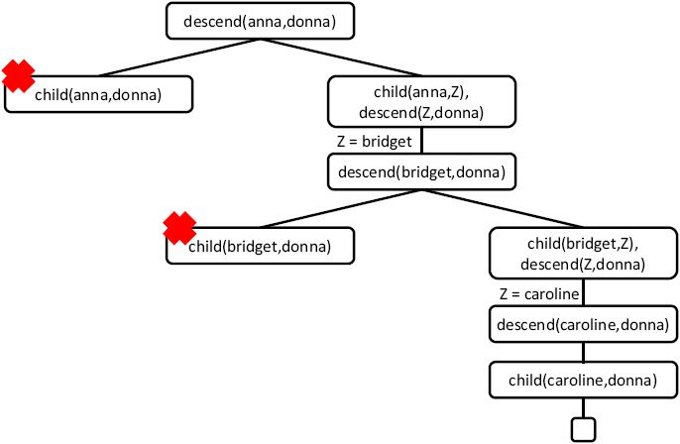
Search Tree
IF331 – PEMROGRAMAN DEKLARATIF – 2023/2024

Slide 63
Example 3: Successor
Suppose we use the following way to write numerals:
0 is a numeral.
If X is a numeral, then so is succ(X).
IF331 – PEMROGRAMAN DEKLARATIF – 2023/2024

Slide 64
Example 3: Successor
numeral(0).
numeral(succ(X)):- numeral(X).
?- numeral(succ(succ(succ(0)))).
yes
?-
IF331 – PEMROGRAMAN DEKLARATIF – 2023/2024

Slide 65
Example 3: Successor
numeral(0).
numeral(succ(X)):- numeral(X).
?- numeral(X).
X=0;
X=succ(0);
X=succ(succ(0));
X=succ(succ(succ(0)));
X=succ(succ(succ(succ(0))))
IF331 – PEMROGRAMAN DEKLARATIF – 2023/2024

Slide 66
Prolog and Logic
Prolog was the first reasonable attempt to create a logic programming language
Programmer gives a declarative specification of the problem, using the language of logic
The programmer should not have to tell the computer what to do
To get information, the programmer simply asks a query
IF331 – PEMROGRAMAN DEKLARATIF – 2023/2024

Slide 67
Prolog and Logic
Prolog does some important steps in this direction, but nevertheless, Prolog is not a full logic programming language!
Prolog has a specific way of answering queries:
Search knowledge base from top to bottom
Processes clauses from left to right
Backtracking to recover from bad choices
IF331 – PEMROGRAMAN DEKLARATIF – 2023/2024

Slide 68
IF331 – PEMROGRAMAN DEKLARATIF
Pertemuan 04 – Lists

Slide 69
Outline
Introduce lists, an important recursive data structure often used in Prolog programming
Define the member/2 predicate, a fundamental Prolog tool for manipulating lists
Illustrate the idea of recursing down lists
IF331 – PEMROGRAMAN DEKLARATIF – 2023/2024

Slide 70
Lists
A list is a finite sequence of elements
Examples of lists in Prolog:
[mia, vincent, jules, yolanda]
[mia, robber(honeybunny), X, 2, mia]
[ ]
[mia, [vincent, jules], [butch, friend(butch)]]
[[ ], dead(z), [2, [b,c]], [ ], Z, [2, [b,c]]]
IF331 – PEMROGRAMAN DEKLARATIF – 2023/2024

Slide 71
Important things about lists
List elements are enclosed in square brackets
The length of a list is the number of elements it has
All sorts of Prolog terms can be elements of a list
There is a special list: the empty list [ ]
IF331 – PEMROGRAMAN DEKLARATIF – 2023/2024

Slide 72
Head and Tail
A non-empty list can be thought of as consisting of two parts
The head
The tail
The head is the first item in the list
The tail is everything else
The tail is the list that remains when we take the first element away
The tail of a list is always a list
IF331 – PEMROGRAMAN DEKLARATIF – 2023/2024

Slide 73
Head and Tail of Empty List
The empty list has neither a head nor a tail
For Prolog, [ ] is a special simple list without any internal structure
The empty list plays an important role in recursive predicates for list processing in Prolog
IF331 – PEMROGRAMAN DEKLARATIF – 2023/2024

Slide 74
The Built-in Operator |
Prolog has a special built-in operator | which can be used to decompose a list into its head and tail
The | operator is a key tool for writing Prolog list manipulation predicates
IF331 – PEMROGRAMAN DEKLARATIF – 2023/2024

Slide 75
The Built-in Operator |
?- [Head|Tail] = [mia, vincent, jules, yolanda].
Head = mia
Tail = [vincent,jules,yolanda]
yes
?-
IF331 – PEMROGRAMAN DEKLARATIF – 2023/2024

Slide 76
Anonymous Variables
There is a simpler way of obtaining only the information we want:
The underscore is the anonymous variable
?- [ _,X2, _,X4|_ ] = [mia, vincent, marsellus, jody, yolanda].
X2 = vincent
X4 = jody
yes
?-
IF331 – PEMROGRAMAN DEKLARATIF – 2023/2024

Slide 77
Member
One of the most basic things we would like to know is whether something is an element of a list or not
So let`s write a predicate that when given a term X and a list L, tells us whether or not X belongs to L
This predicate is usually called member/2
IF331 – PEMROGRAMAN DEKLARATIF – 2023/2024

Slide 78
member/2
member(X,[X|T]).
member(X,[H|T]):- member(X,T).
?- member(yolanda,[yolanda,trudy,vincent,jules]).
yes
?-
IF331 – PEMROGRAMAN DEKLARATIF – 2023/2024

Slide 79
member/2
member(X,[X|T]).
member(X,[H|T]):- member(X,T).
?- member(zed,[yolanda,trudy,vincent,jules]).
no
?-
IF331 – PEMROGRAMAN DEKLARATIF – 2023/2024

Slide 80
member/2
member(X,[X|T]).
member(X,[H|T]):- member(X,T).
?- member(X,[yolanda,trudy,vincent,jules]).
X = yolanda;
X = trudy;
X = vincent;
X = jules;
no
IF331 – PEMROGRAMAN DEKLARATIF – 2023/2024

Slide 81
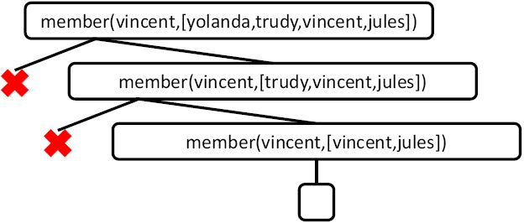
member/2
IF331 – PEMROGRAMAN DEKLARATIF – 2023/2024

Slide 82
Rewriting member/2
member(X,[X|_]).
member(X,[_|T]):- member(X,T).
IF331 – PEMROGRAMAN DEKLARATIF – 2023/2024

Slide 83
Recursing Down Lists
The member/2 predicate works by recursively working its way down a list
doing something to the head, and then
recursively doing the same thing to the tail
This technique is very common in Prolog and therefore very important that you master it
So let`s look at another example!
IF331 – PEMROGRAMAN DEKLARATIF – 2023/2024

Slide 84
Example: a2b/2
The predicate a2b/2 takes two lists as arguments and succeeds
if the first argument is a list of as, and
the second argument is a list of bs of exactly the same length
?- a2b([a,a,a,a],[b,b,b,b]).
yes
?- a2b([a,a,a,a],[b,b,b]).
no
?- a2b([a,c,a,a],[b,b,b,t]).
no
IF331 – PEMROGRAMAN DEKLARATIF – 2023/2024

Slide 85
Defining a2b/2: Step 1
a2b([],[]).
Often the best away to solve such problems is to think about the simplest possible case
Here it means: the empty list
IF331 – PEMROGRAMAN DEKLARATIF – 2023/2024

Slide 86
Defining a2b/2: Step 2
a2b([],[]).
a2b([a|L1],[b|L2]):- a2b(L1,L2).
Now think recursively!
When should a2b/2 decide that two non-empty lists are a list of as and a list of bs of exactly the same length?
IF331 – PEMROGRAMAN DEKLARATIF – 2023/2024

Slide 87
Testing a2b/2
a2b([],[]).
a2b([a|L1],[b|L2]):- a2b(L1,L2).
?- a2b([a,a,a],[b,b,b]).
yes
?-
IF331 – PEMROGRAMAN DEKLARATIF – 2023/2024

Slide 88
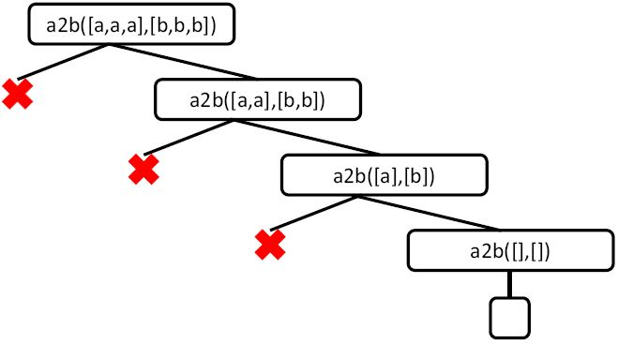
Testing a2b/2
IF331 – PEMROGRAMAN DEKLARATIF – 2023/2024

Slide 89
IF331 – PEMROGRAMAN DEKLARATIF
Pertemuan 05 – Arithmetic

Slide 90
Outline
Introduce Prolog`s built-in abilities for performing arithmetic
Apply these to simple list processing problems, using accumulators
Look at tail-recursive predicates and explain why they are more efficient than predicates that are not tail-recursive
IF331 – PEMROGRAMAN DEKLARATIF – 2023/2024

Slide 91
Arithmetic in Prolog
Prolog provides a number of basic arithmetic tools
Integer and real numbers
Arithmetic
Prolog
2 + 3 = 5
3 x 4 = 12
5 – 3 = 2
3 – 5 = -2
4 : 2 = 2
1 is the remainder when 7 is divided by 2
?- 5 is 2+3.
?- 12 is 3∗4.
?- 2 is 5-3.
?- -2 is 3-5.
?- 2 is 4/2.
?- 1 is mod(7,2).
IF331 – PEMROGRAMAN DEKLARATIF – 2023/2024

Slide 92
A Closer Look
It is important to know that +, -, / and ∗ do not carry out any arithmetic
Expressions such as 3+2, 4-7, 5/5 are ordinary Prolog terms
Functor: +, -, /, ∗
Arity: 2
Arguments: integers
IF331 – PEMROGRAMAN DEKLARATIF – 2023/2024

Slide 93
The is/2 Predicate
To force Prolog to actually evaluate arithmetic expressions, we have to use is just as we did in the other examples
This is an instruction for Prolog to carry out calculations
Because this is not an ordinary Prolog predicate, there are some restrictions
IF331 – PEMROGRAMAN DEKLARATIF – 2023/2024

Slide 94
The is/2 Predicate
?- X is 3 + 2.
X = 5
yes
?- 3 + 2 is X.
ERROR: is/2: Arguments are not sufficiently instantiated
?- Result is 2+2+2+2+2.
Result = 10
yes
?-
IF331 – PEMROGRAMAN DEKLARATIF – 2023/2024

Slide 95
Restrictions on Use of is/2
We are free to use variables on the right hand side of the is predicate
But when Prolog actually carries out the evaluation, the variables must be instantiated with a variable-free Prolog term
This Prolog term must be an arithmetic expression
IF331 – PEMROGRAMAN DEKLARATIF – 2023/2024

Slide 96
Notation
Two final remarks on arithmetic expressions
3+2, 4/2, 4-5 are just ordinary Prolog terms in a user-friendly notation: 3+2 is really +(3,2) and so on.
Also the is predicate is a two-place Prolog predicate
?- is(X,+(3,2)).
X = 5
yes
IF331 – PEMROGRAMAN DEKLARATIF – 2023/2024

Slide 97
Arithmetic and Lists
How long is a list?
The empty list has length: zero;
A non-empty list has length: one plus length of its tail.
IF331 – PEMROGRAMAN DEKLARATIF – 2023/2024

Slide 98
Length of A List in Prolog
len([],0).
len([_|L],N):-
len(L,X),
N is X + 1.
?- len([a,b,c,d,e,[a,x],t],X).
X=7
yes
?-
IF331 – PEMROGRAMAN DEKLARATIF – 2023/2024

Slide 99
Accumulators
This is quite a good program
Easy to understand
Relatively efficient
But there is another method of finding the length of a list
Introduce the idea of accumulators
Accumulators are variables that hold intermediate results
IF331 – PEMROGRAMAN DEKLARATIF – 2023/2024

Slide 100
Defining acclen/3
The predicate acclen/3 has three arguments
The list whose length we want to find
The length of the list, an integer
An accumulator, keeping track of the intermediate values for the length
IF331 – PEMROGRAMAN DEKLARATIF – 2023/2024

Slide 101
Defining acclen/3
The accumulator of acclen/3
Initial value of the accumulator is 0
Add 1 to accumulator each time we can recursively take the head of a list
When we reach the empty list, the accumulator contains the length of the list
IF331 – PEMROGRAMAN DEKLARATIF – 2023/2024

Slide 102
Length of A List in Prolog
Add 1 to the accumulator each time we take off a head from the list
acclen([],Acc,Length):-
Length = Acc.
acclen([_|L],OldAcc,Length):-
NewAcc is OldAcc + 1,
acclen(L,NewAcc,Length).
?-
IF331 – PEMROGRAMAN DEKLARATIF – 2023/2024

Slide 103
Length of A List in Prolog
acclen([],Acc,Length):-
Length = Acc.
acclen([_|L],OldAcc,Length):-
NewAcc is OldAcc + 1,
acclen(L,NewAcc,Length).
When we reach the empty list, the accumulator contains the length of the list
?-
IF331 – PEMROGRAMAN DEKLARATIF – 2023/2024

Slide 104
Length of A List in Prolog
acclen([],Acc,Acc).
acclen([_|L],OldAcc,Length):-
NewAcc is OldAcc + 1,
acclen(L,NewAcc,Length).
?-acclen([a,b,c],0,Len).
Len=3
yes
?-
IF331 – PEMROGRAMAN DEKLARATIF – 2023/2024

Slide 105
Search Tree for acclen/3
acclen([],Acc,Acc).
acclen([_|L],OldAcc,Length):-
NewAcc is OldAcc + 1,
acclen(L,NewAcc,Length).
?- acclen([a,b,c],0,Len).
/ \
no ?- acclen([b,c],1,Len).
/ \
no ?- acclen([c],2,Len).
/ \
no ?- acclen([],3,Len).
/ \
Len=3 no
IF331 – PEMROGRAMAN DEKLARATIF – 2023/2024

Slide 106
Adding A Wrapper Predicate
acclen([ ],Acc,Acc).
acclen([ _|L],OldAcc,Length):-
NewAcc is OldAcc + 1,
acclen(L,NewAcc,Length).
length(List,Length):-
acclen(List,0,Length).
?-length([a,b,c], X).
X=3
yes
IF331 – PEMROGRAMAN DEKLARATIF – 2023/2024

Slide 107
Tail Recursion
Why is acclen/3 better than len/2 ?
acclen/3 is tail-recursive, and len/2 is not
Difference:
In tail recursive predicates the results is fully calculated once we reach the base clause
In recursive predicates that are not tail recursive, there are still goals on the stack when we reach the base clause
IF331 – PEMROGRAMAN DEKLARATIF – 2023/2024

Slide 108
Comparison
Not tail-recursive
Tail-recursive
len([],0).
len([_|L],NewLength):-
len(L,Length),
NewLength is Length + 1.
acclen([],Acc,Acc).
acclen([_|L],OldAcc,Length):-
NewAcc is OldAcc + 1,
acclen(L,NewAcc,Length).
IF331 – PEMROGRAMAN DEKLARATIF – 2023/2024

Slide 109
Search Tree for len/2
len([],0).
len([_|L],NewLength):-
len(L,Length),
NewLength is Length + 1.
?- len([a,b,c], Len).
/ \
no ?- len([b,c],Len1), Len is Len1 + 1.
/ \
no ?- len([c], Len2), Len1 is Len2+1, Len is Len1+1. / \
no ?- len([], Len3), Len2 is Len3+1, Len1 is Len2+1,
Len is Len1 + 1. / \
Len3=0, Len2=1, no
Len1=2, Len=3
IF331 – PEMROGRAMAN DEKLARATIF – 2023/2024

Slide 110
Search Tree for acclen/3
acclen([],Acc,Acc).
acclen([_|L],OldAcc,Length):-
NewAcc is OldAcc + 1,
acclen(L,NewAcc,Length).
?- acclen([a,b,c],0,Len).
/ \
no ?- acclen([b,c],1,Len).
/ \
no ?- acclen([c],2,Len).
/ \
no ?- acclen([],3,Len).
/ \
Len=3 no
IF331 – PEMROGRAMAN DEKLARATIF – 2023/2024

Slide 111
Comparing Integers
Some Prolog arithmetic predicates actually do carry out arithmetic by themselves
These are the operators that compare integers
IF331 – PEMROGRAMAN DEKLARATIF – 2023/2024

Slide 112
Comparing Integers
Arithmetic
Prolog
x < y
x ≤ y
x = y
x ≠ y
x ≥ y
x > y
X < Y
X =< Y
X =:= Y
X =\= Y
X >= Y
X > Y
IF331 – PEMROGRAMAN DEKLARATIF – 2023/2024

Slide 113
Comparison Operators
Have the obvious meaning
Force both left and right hand argument to be evaluated
?- 2 < 4+1.
yes
?- 4+3 > 5+5.
no
IF331 – PEMROGRAMAN DEKLARATIF – 2023/2024

Slide 114
Comparison Operators
Have the obvious meaning
Force both left and right hand argument to be evaluated
?- 4 = 4.
yes
?- 2+2 = 4.
no
?- 2+2 =:= 4.
yes
IF331 – PEMROGRAMAN DEKLARATIF – 2023/2024

Slide 115
Comparing Numbers
We are going to define a predicate that takes two arguments, and is true when:
The first argument is a list of integers
The second argument is the highest integer in the list
Basic idea
We will use an accumulator
The accumulator keeps track of the highest value encountered so far
If we find a higher value, the accumulator will be updated
IF331 – PEMROGRAMAN DEKLARATIF – 2023/2024

Slide 116
Definition of accMax/3
accMax([H|T],A,Max):-
H > A,
accMax(T,H,Max).
accMax([H|T],A,Max):-
H =< A,
accMax(T,A,Max).
accMax([],A,A).
?- accMax([1,0,5,4],0,Max).
Max=5
yes
IF331 – PEMROGRAMAN DEKLARATIF – 2023/2024

Slide 117
Adding A Wrapper max/2
accMax([H|T],A,Max):-
H > A,
accMax(T,H,Max).
accMax([H|T],A,Max):-
H =< A,
accMax(T,A,Max).
accMax([],A,A).
max([H|T],Max):-
accMax(T,H,Max).
?- max([1,0,5,4], Max).
Max=5
yes
?- max([-3, -1, -5, -4], Max).
Max= -1
yes
?-
IF331 – PEMROGRAMAN DEKLARATIF – 2023/2024

Slide 118
IF331 – PEMROGRAMAN DEKLARATIF
Pertemuan 06 – More Lists

Slide 119
Outline
Define append/3, a predicate for concatenating two lists, and illustrate what can be done with it
Discuss two ways of reversing a list
A naïve way using append/3
A more efficient method using accumulators
IF331 – PEMROGRAMAN DEKLARATIF – 2023/2024

Slide 120
Append
We will define an important predicate append/3 whose arguments are all lists
Declaratively, append(L1,L2,L3) is true if list L3 is the result of concatenating the lists L1 and L2 together
?- append([a,b,c,d],[3,4,5],[a,b,c,d,3,4,5]).
yes
?- append([a,b,c],[3,4,5],[a,b,c,d,3,4,5]).
no
IF331 – PEMROGRAMAN DEKLARATIF – 2023/2024

Slide 121
Append Viewed Procedurally
From a procedural perspective, the most obvious use of append/3 is to concatenate two lists together
We can do this simply by using a variable as third argument
?- append([a,b,c,d],[1,2,3,4,5], X).
X=[a,b,c,d,1,2,3,4,5]
yes
?-
IF331 – PEMROGRAMAN DEKLARATIF – 2023/2024

Slide 122
Definition of append/3
append([], L, L).
append([H|L1], L2, [H|L3]):-
append(L1, L2, L3).
Recursive definition
Base clause: appending the empty list to any list produces that same list
The recursive step says that when concatenating a non-empty list [H|T] with a list L, the result is a list with head H and the result of concatenating T and L
IF331 – PEMROGRAMAN DEKLARATIF – 2023/2024

Slide 123
How append/3 Works
Two ways to find out:
Use trace/0 on some examples
Draw a search tree! Let us consider a simple example
?- append([a,b,c],[1,2,3], R).
IF331 – PEMROGRAMAN DEKLARATIF – 2023/2024

Slide 124
Search Tree Example
append([], L, L).
append([H|L1], L2, [H|L3]):-
append(L1, L2, L3).
?- append([a,b,c],[1,2,3], R).
/ \
† R = [a|L0] ?- append([b,c],[1,2,3],L0) / \
† L0=[b|L1] ?- append([c],[1,2,3],L1)
/ \
† L1=[c|L2] ?- append([],[1,2,3],L2)
/ \
L2=[1,2,3] †
L2=[1,2,3]
L1=[c|L2]=[c,1,2,3]
L0=[b|L1]=[b,c,1,2,3]
R=[a|L0]=[a,b,c,1,2,3]
IF331 – PEMROGRAMAN DEKLARATIF – 2023/2024

Slide 125
Using append/3
Now that we understand how append/3 works, let`s look at some applications
Splitting up a list:
?- append(X,Y, [a,b,c,d]).
X=[ ] Y=[a,b,c,d];
X=[a] Y=[b,c,d];
X=[a,b] Y=[c,d];
X=[a,b,c] Y=[d];
X=[a,b,c,d] Y=[ ];
no
IF331 – PEMROGRAMAN DEKLARATIF – 2023/2024

Slide 126
Use of prefix/2
prefix(P,L):-
append(P,_,L).
?- prefix(X, [a,b,c,d]).
X=[ ];
X=[a];
X=[a,b];
X=[a,b,c];
X=[a,b,c,d];
no
IF331 – PEMROGRAMAN DEKLARATIF – 2023/2024

Slide 127
Use of suffix/2
suffix(S,L):-
append(_,S,L).
?- suffix(X, [a,b,c,d]).
X=[a,b,c,d];
X=[b,c,d];
X=[c,d];
X=[d];
X=[];
no
IF331 – PEMROGRAMAN DEKLARATIF – 2023/2024

Slide 128
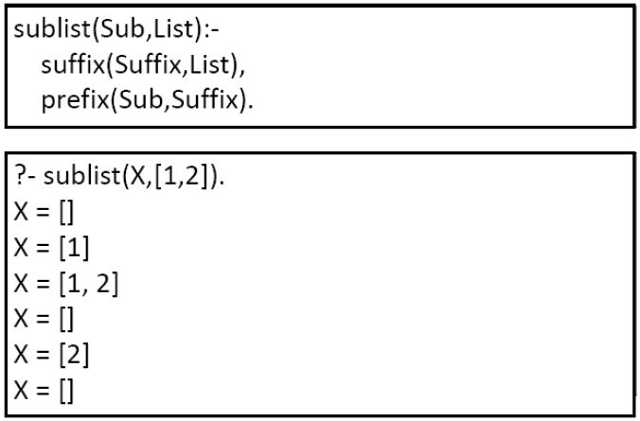
Use of sublist/2
IF331 – PEMROGRAMAN DEKLARATIF – 2023/2024

Slide 129
Reversing a List
We will illustrate the problem with append/3 by using it to reverse the elements of a list
That is we will define a predicate that changes a list [a,b,c,d,e] into a list [e,d,c,b,a]
This would be a useful tool to have, as Prolog only allows easy access to the front of the list
IF331 – PEMROGRAMAN DEKLARATIF – 2023/2024

Slide 130
Naïve Reverse
Recursive definition
If we reverse the empty list, we obtain the empty list
If we reverse the list [H|T], we end up with the list obtained by reversing T and concatenating it with [H]
To see that this definition is correct, consider the list [a,b,c,d].
If we reverse the tail of this list we get [d,c,b].
Concatenating this with [a] yields [d,c,b,a]
IF331 – PEMROGRAMAN DEKLARATIF – 2023/2024

Slide 131
Naïve Reverse in Prolog
naiveReverse([],[]).
naiveReverse([H|T],R):-
naiveReverse(T,RT),
append(RT,[H],R).
This definition is correct, but it does an awful lot of work
It spends a lot of time carrying out appends
But there is a better way…
IF331 – PEMROGRAMAN DEKLARATIF – 2023/2024

Slide 132
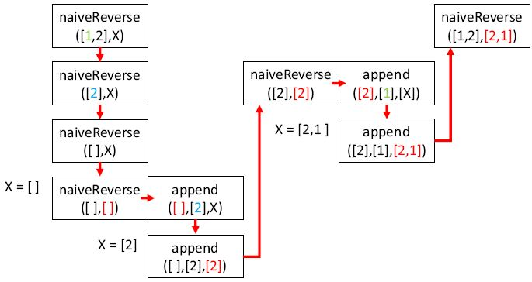
Naïve Reverse in Prolog
IF331 – PEMROGRAMAN DEKLARATIF – 2023/2024

Slide 133
Reverse Using an Accumulator
The better way is using an accumulator
The accumulator will be a list, and when we start reversing it will be empty
We simply take the head of the list that we want to reverse and add it to the the head of the accumulator list
We continue this until we hit the empty list
At this point the accumulator will contain the reversed list!
IF331 – PEMROGRAMAN DEKLARATIF – 2023/2024

Slide 134
Reverse Using an Accumulator
accReverse([ ],L,L).
accReverse([H|T],Acc,Rev):-
accReverse(T,[H|Acc],Rev).
IF331 – PEMROGRAMAN DEKLARATIF – 2023/2024

Slide 135
Adding a Wrapper Predicate
accReverse([ ],L,L).
accReverse([H|T],Acc,Rev):-
accReverse(T,[H|Acc],Rev).
reverse(L1,L2):-
accReverse(L1,[ ],L2).
IF331 – PEMROGRAMAN DEKLARATIF – 2023/2024

Slide 136
Illustration of The Accumulator
List: [a,b,c,d]
Accumulator: []
accReverse([ ],L,L).
accReverse([H|T],Acc,Rev):-
accReverse(T,[H|Acc],Rev).
IF331 – PEMROGRAMAN DEKLARATIF – 2023/2024

Slide 137
Illustration of The Accumulator
List: [a,b,c,d]
List: [b,c,d]
Accumulator: []
Accumulator: [a]
accReverse([ ],L,L).
accReverse([H|T],Acc,Rev):-
accReverse(T,[H|Acc],Rev).
IF331 – PEMROGRAMAN DEKLARATIF – 2023/2024

Slide 138
Illustration of The Accumulator
List: [a,b,c,d]
List: [b,c,d]
List: [c,d]
Accumulator: []
Accumulator: [a]
Accumulator: [b,a]
accReverse([ ],L,L).
accReverse([H|T],Acc,Rev):-
accReverse(T,[H|Acc],Rev).
IF331 – PEMROGRAMAN DEKLARATIF – 2023/2024

Slide 139
Illustration of The Accumulator
List: [a,b,c,d]
List: [b,c,d]
List: [c,d]
List: [d]
Accumulator: []
Accumulator: [a]
Accumulator: [b,a]
Accumulator: [c,b,a]
accReverse([ ],L,L).
accReverse([H|T],Acc,Rev):-
accReverse(T,[H|Acc],Rev).
IF331 – PEMROGRAMAN DEKLARATIF – 2023/2024

Slide 140
Illustration of The Accumulator
List: [a,b,c,d]
List: [b,c,d]
List: [c,d]
List: [d]
List: []
Accumulator: []
Accumulator: [a]
Accumulator: [b,a]
Accumulator: [c,b,a]
Accumulator: [d,c,b,a]
accReverse([ ],L,L).
accReverse([H|T],Acc,Rev):-
accReverse(T,[H|Acc],Rev).
IF331 – PEMROGRAMAN DEKLARATIF – 2023/2024

Slide 141
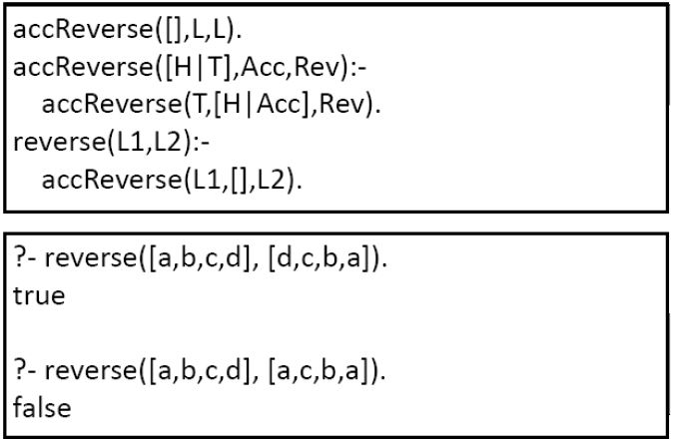
Use of reverse/2
IF331 – PEMROGRAMAN DEKLARATIF – 2023/2024

Slide 142
References
Patrick Blackburn, Johan Bos and Kristina Striegnitz (2001), Learn Prolog Now!, College Publication
IF331 – PEMROGRAMAN DEKLARATIF – 2023/2024

